Slide 1

Multimodal Cryptocurrency Price Forecasting with Explainable AI and Sentiment Analysis
Atishay Jain
A20609413

Slide 2
Mid – Term Highlights
Collected and pre-processed OHLCV data, extending dataset from 2014 to 2024 using CryptoCompare, Binance, etc.
Performed Preprocessing and added multiple technical indicators during feature engineering.
Trained NBEATS and TFT models and performed combined inference
Achieved:
MAE: 504.7925
RMSE: 636.5246
MSE: 405163
MAPE: 0.6021 SMAPE: 0.6015
R2: 0.6550

Slide 3
Step | What it Does | Why It Helps the Model
Datetime Parsing & Resampling | Converts timestamps to hourly intervals and fills missing data | Ensures time consistency and regular input spacing for sequence models
Stationarity Check (ADF Test) | Tests if price series has constant statistical properties | Determines if transformation (like differencing) is needed
Differencing (close.diff()) | Converts non-stationary price to stationary returns (close_diff) | Helps model learn on stable, mean-reverting data rather than drifting prices
Technical Indicators (e.g., RSI, MACD, OBV) | Adds market signals | Enriches model with signals traders use — improves context
Lag Features (close_lag_1, ..., close_lag_6) | Adds previous close values | Lets the model learn temporal dependencies and price momentum
Log Returns & Volatility | Computes log returns and rolling volatility | Helps model understand price risk and scale of movement
Calendar Features (hour, day, etc.) | Encodes time-based patterns | Captures seasonality, like hourly or weekly trading behavior
Fourier Features | Adds continuous seasonality components | Improves model performance on cyclical trends (like hourly spikes)
Scaling (Scaler.fit_transform) | Normalizes input features per type | Prevents certain features from dominating due to scale differences

Slide 4
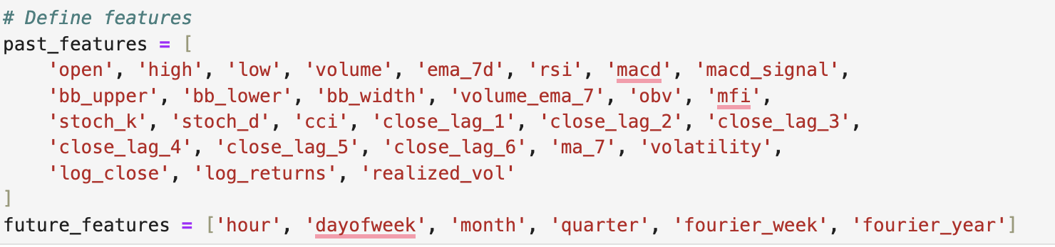
Additional Columns

Slide 5
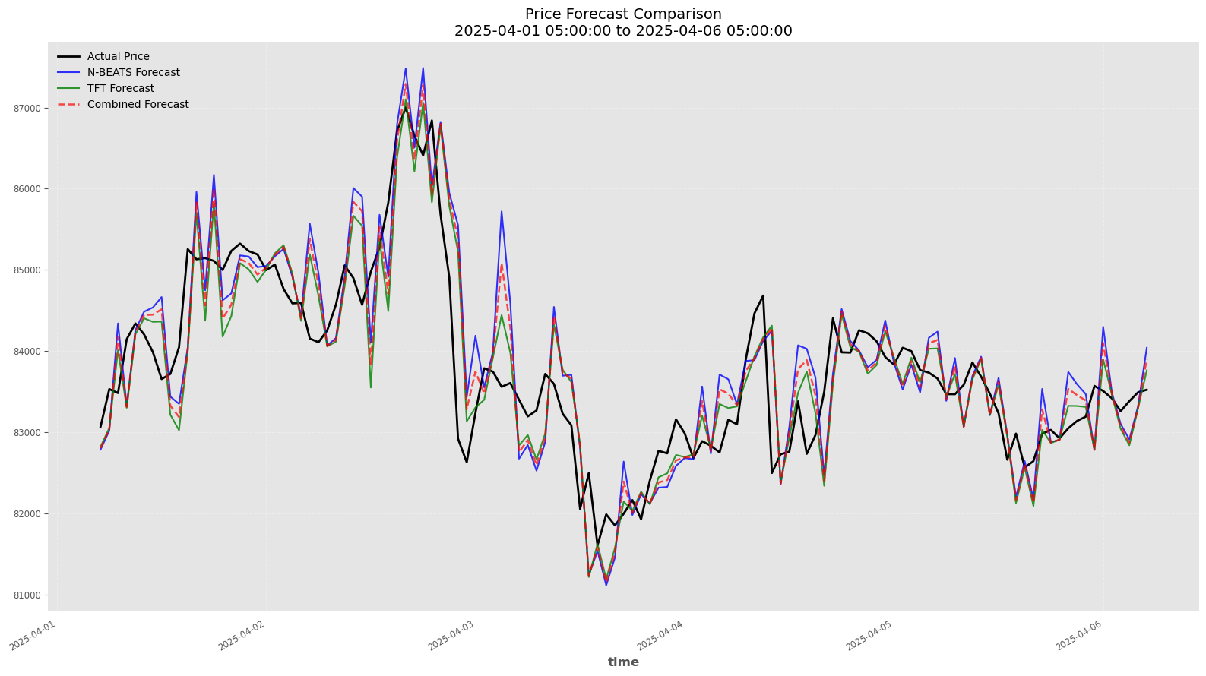
Price Forecast Comparison

Slide 6
Phase -2 Overview
Collected sentiment data, performed preprocessing, and added sentiment-based features.
Trained NBEATS and TFT models using Chameleon on a GPU virtual machine (VM) with increased epochs for better convergence.
Integrated an explainability module to enhance model interpretability.
Achieved improved model accuracy compared to earlier results.

Slide 7
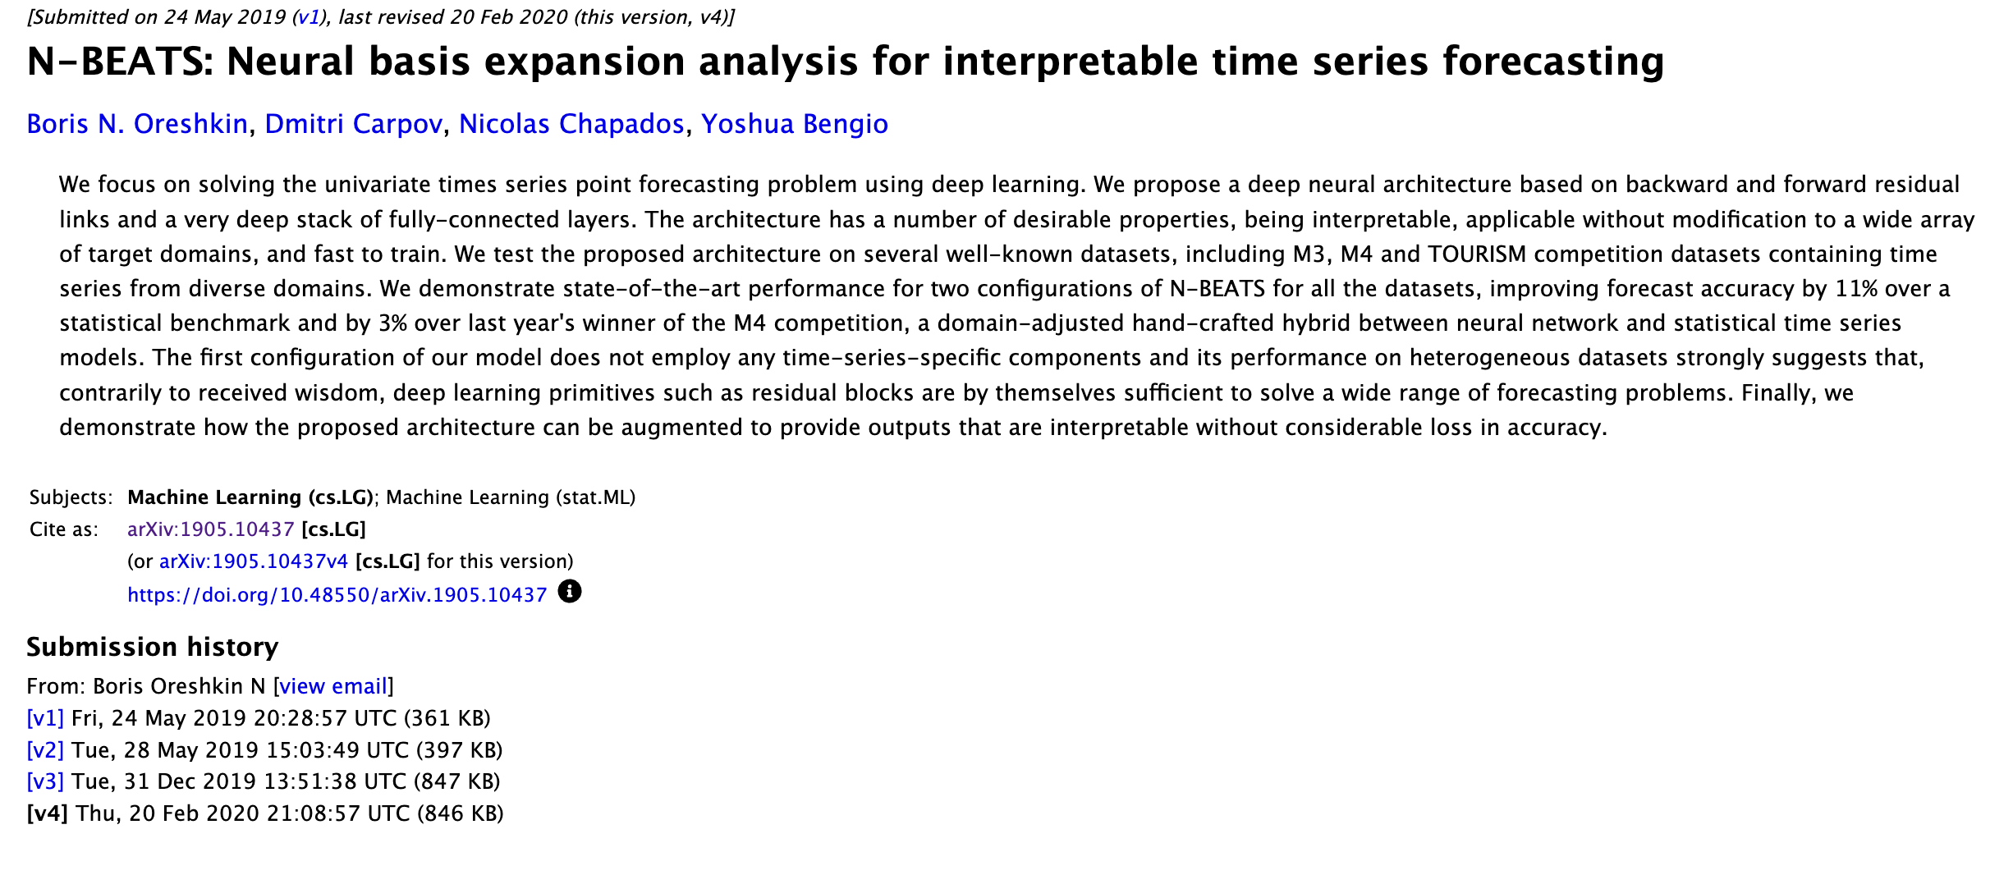
Reference Paper 1

Slide 8
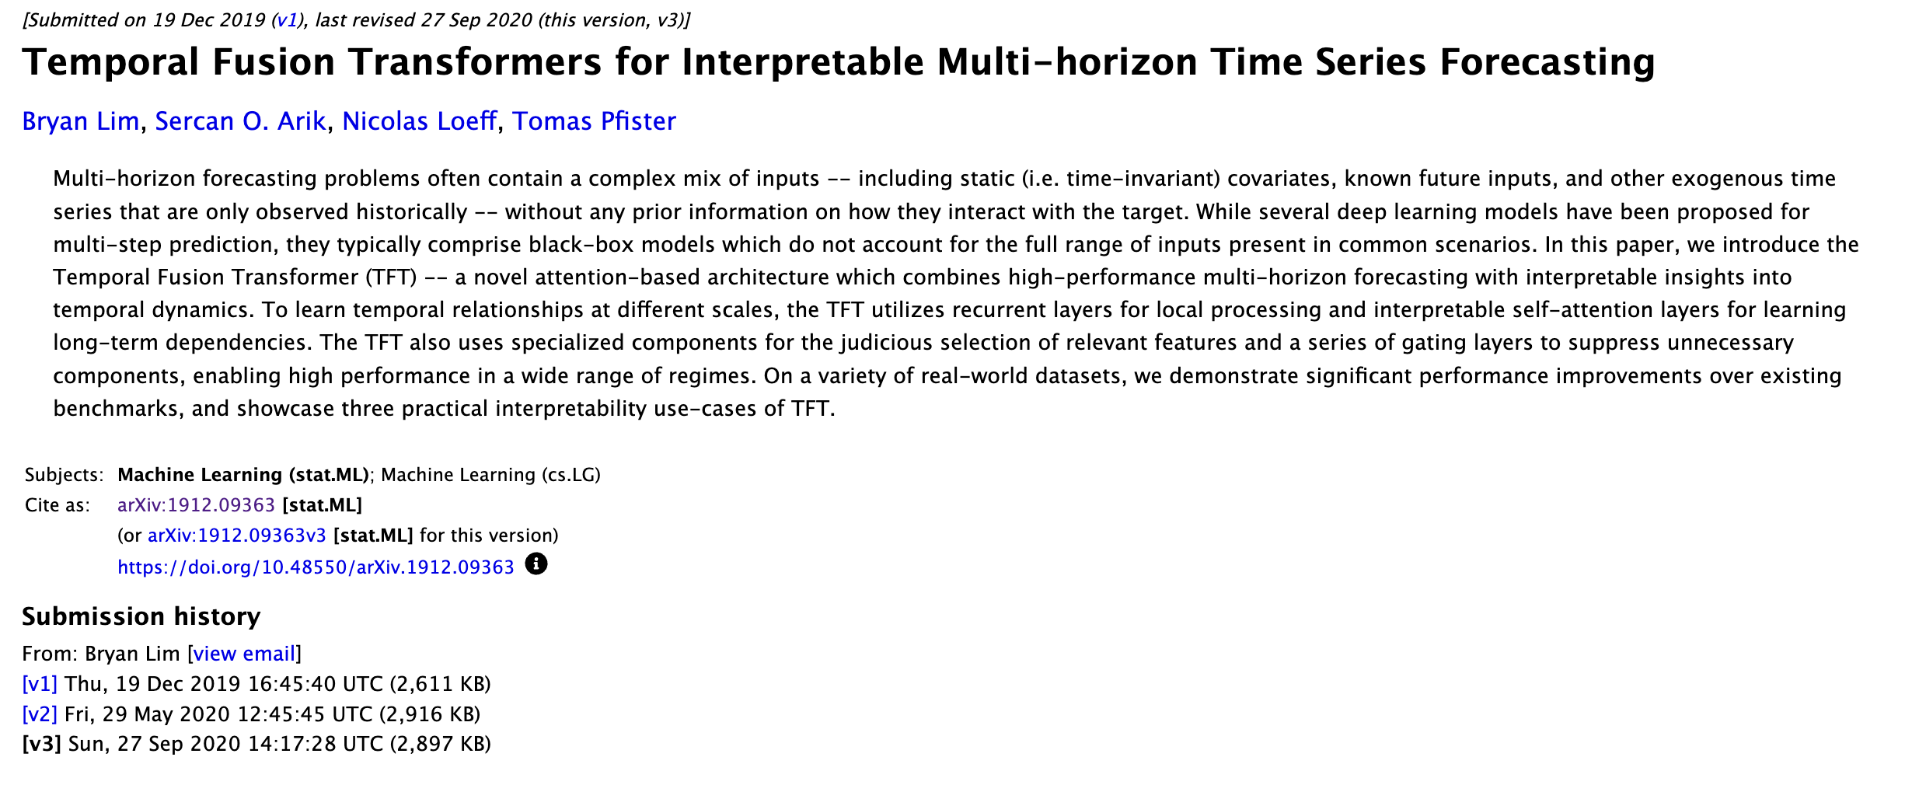
Reference Paper 2

Slide 9
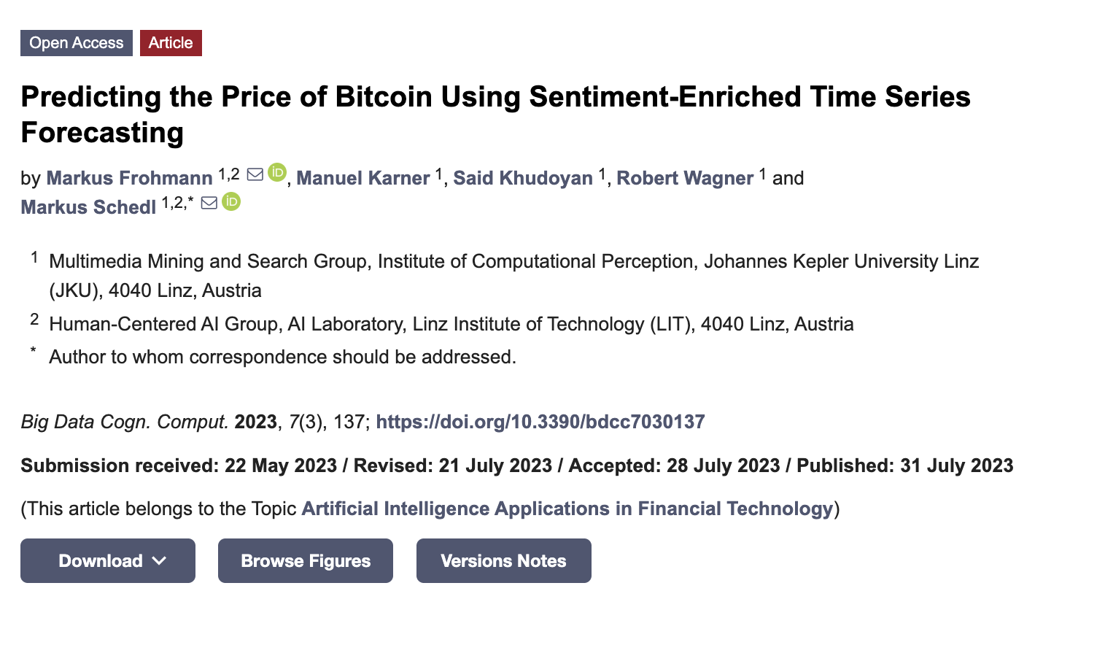
Reference Paper 3

Slide 10
Architecture

Slide 11
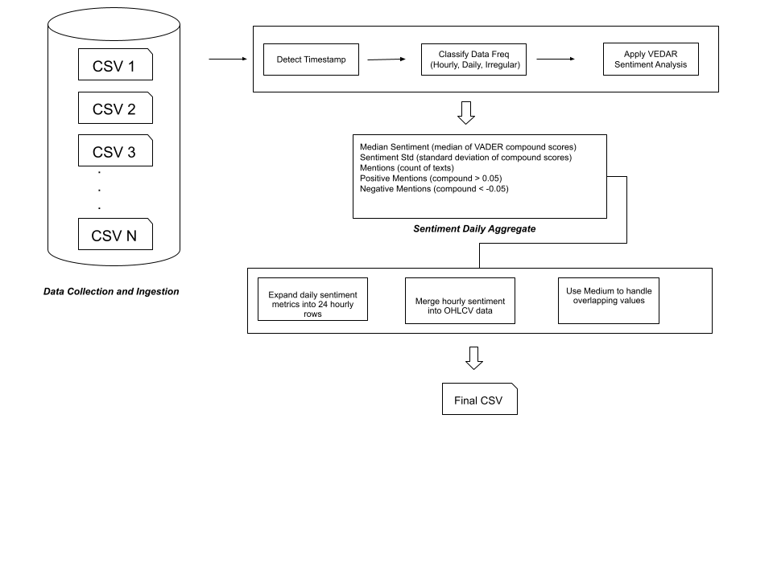
Sentiment Pipeline

Slide 12
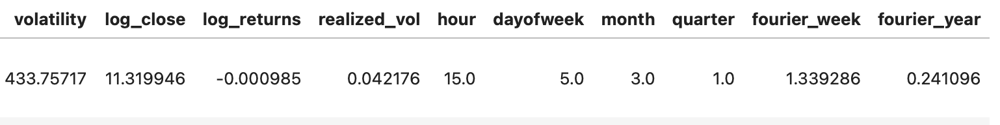
Prepared Dataset

Slide 13
Modelling with Darts Library
Used Darts NBEATSModel and TFTModel implementations.
Configured with input/output chunk lengths of 24 hours.
TFT used both past and future covariates for context.
Models trained with PyTorch Lightning backend.

Slide 14
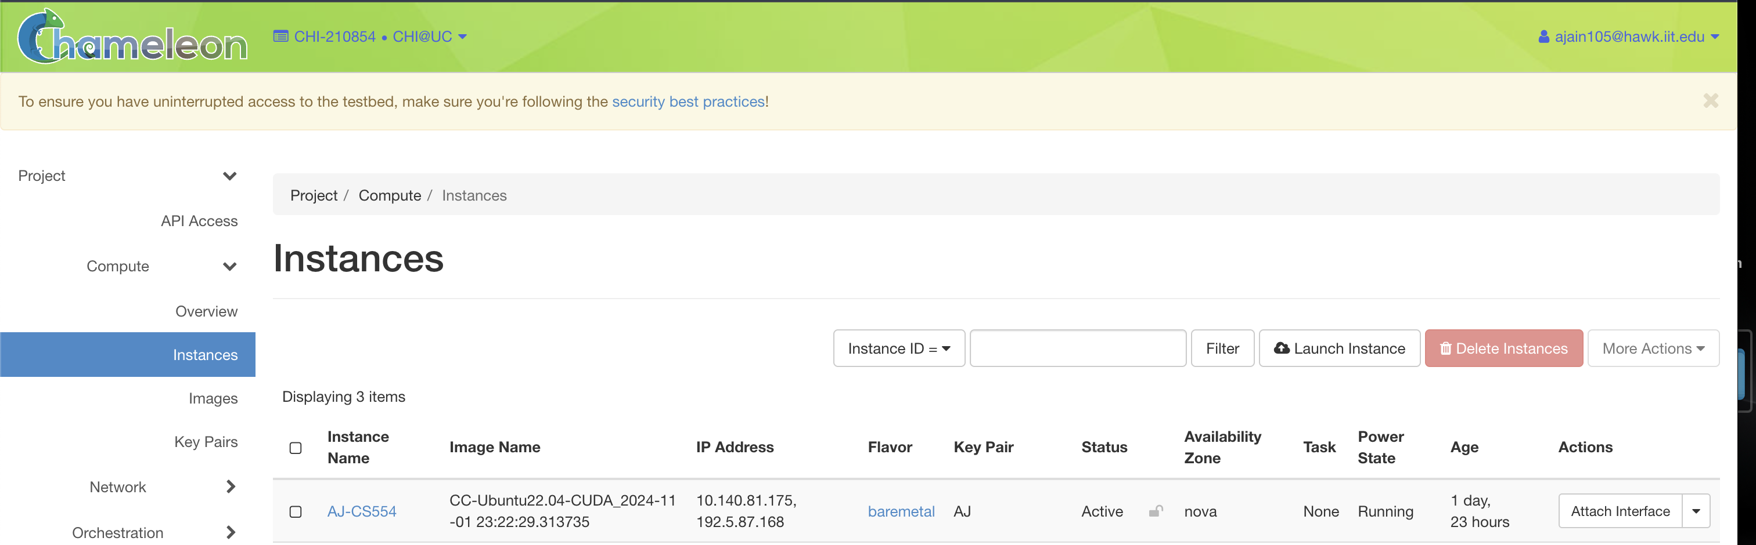
Model Training
Image: CC-Ubuntu-CUDA
GPU: RTX 6000

Slide 15
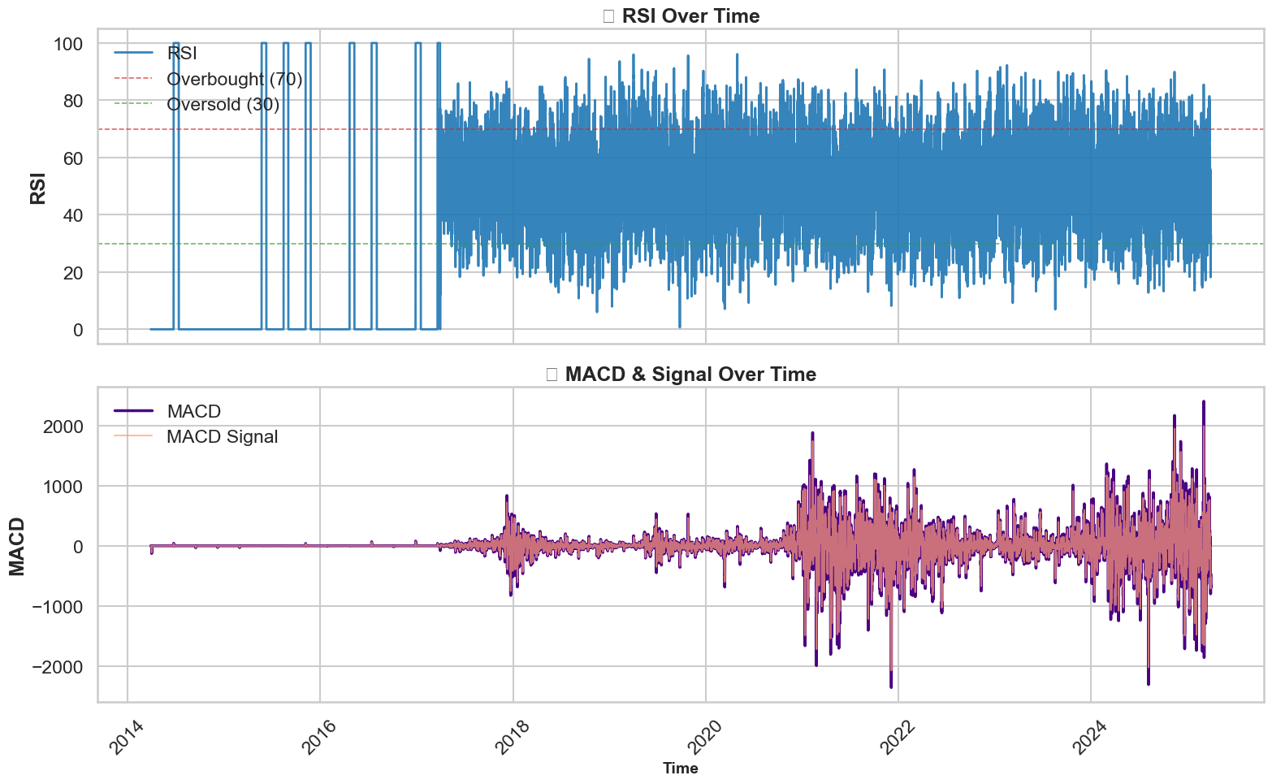
Features Over Time

Slide 16
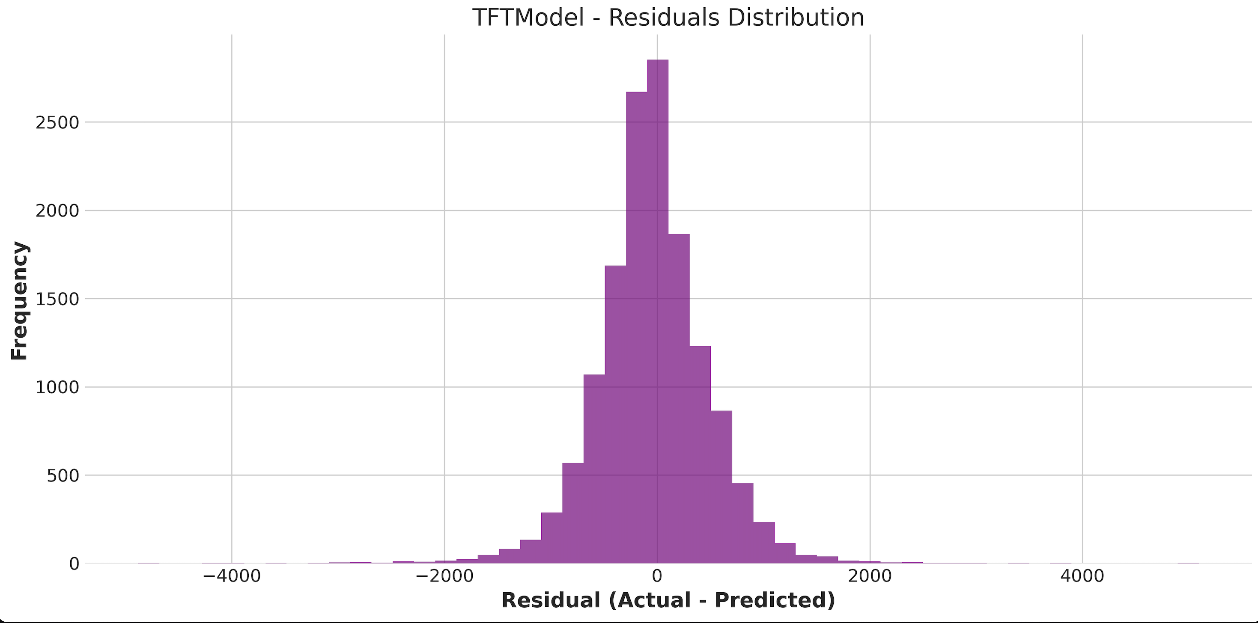
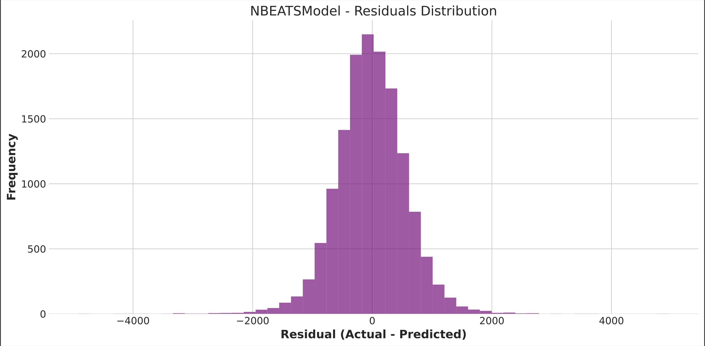
Model Residual Distribution

Slide 17
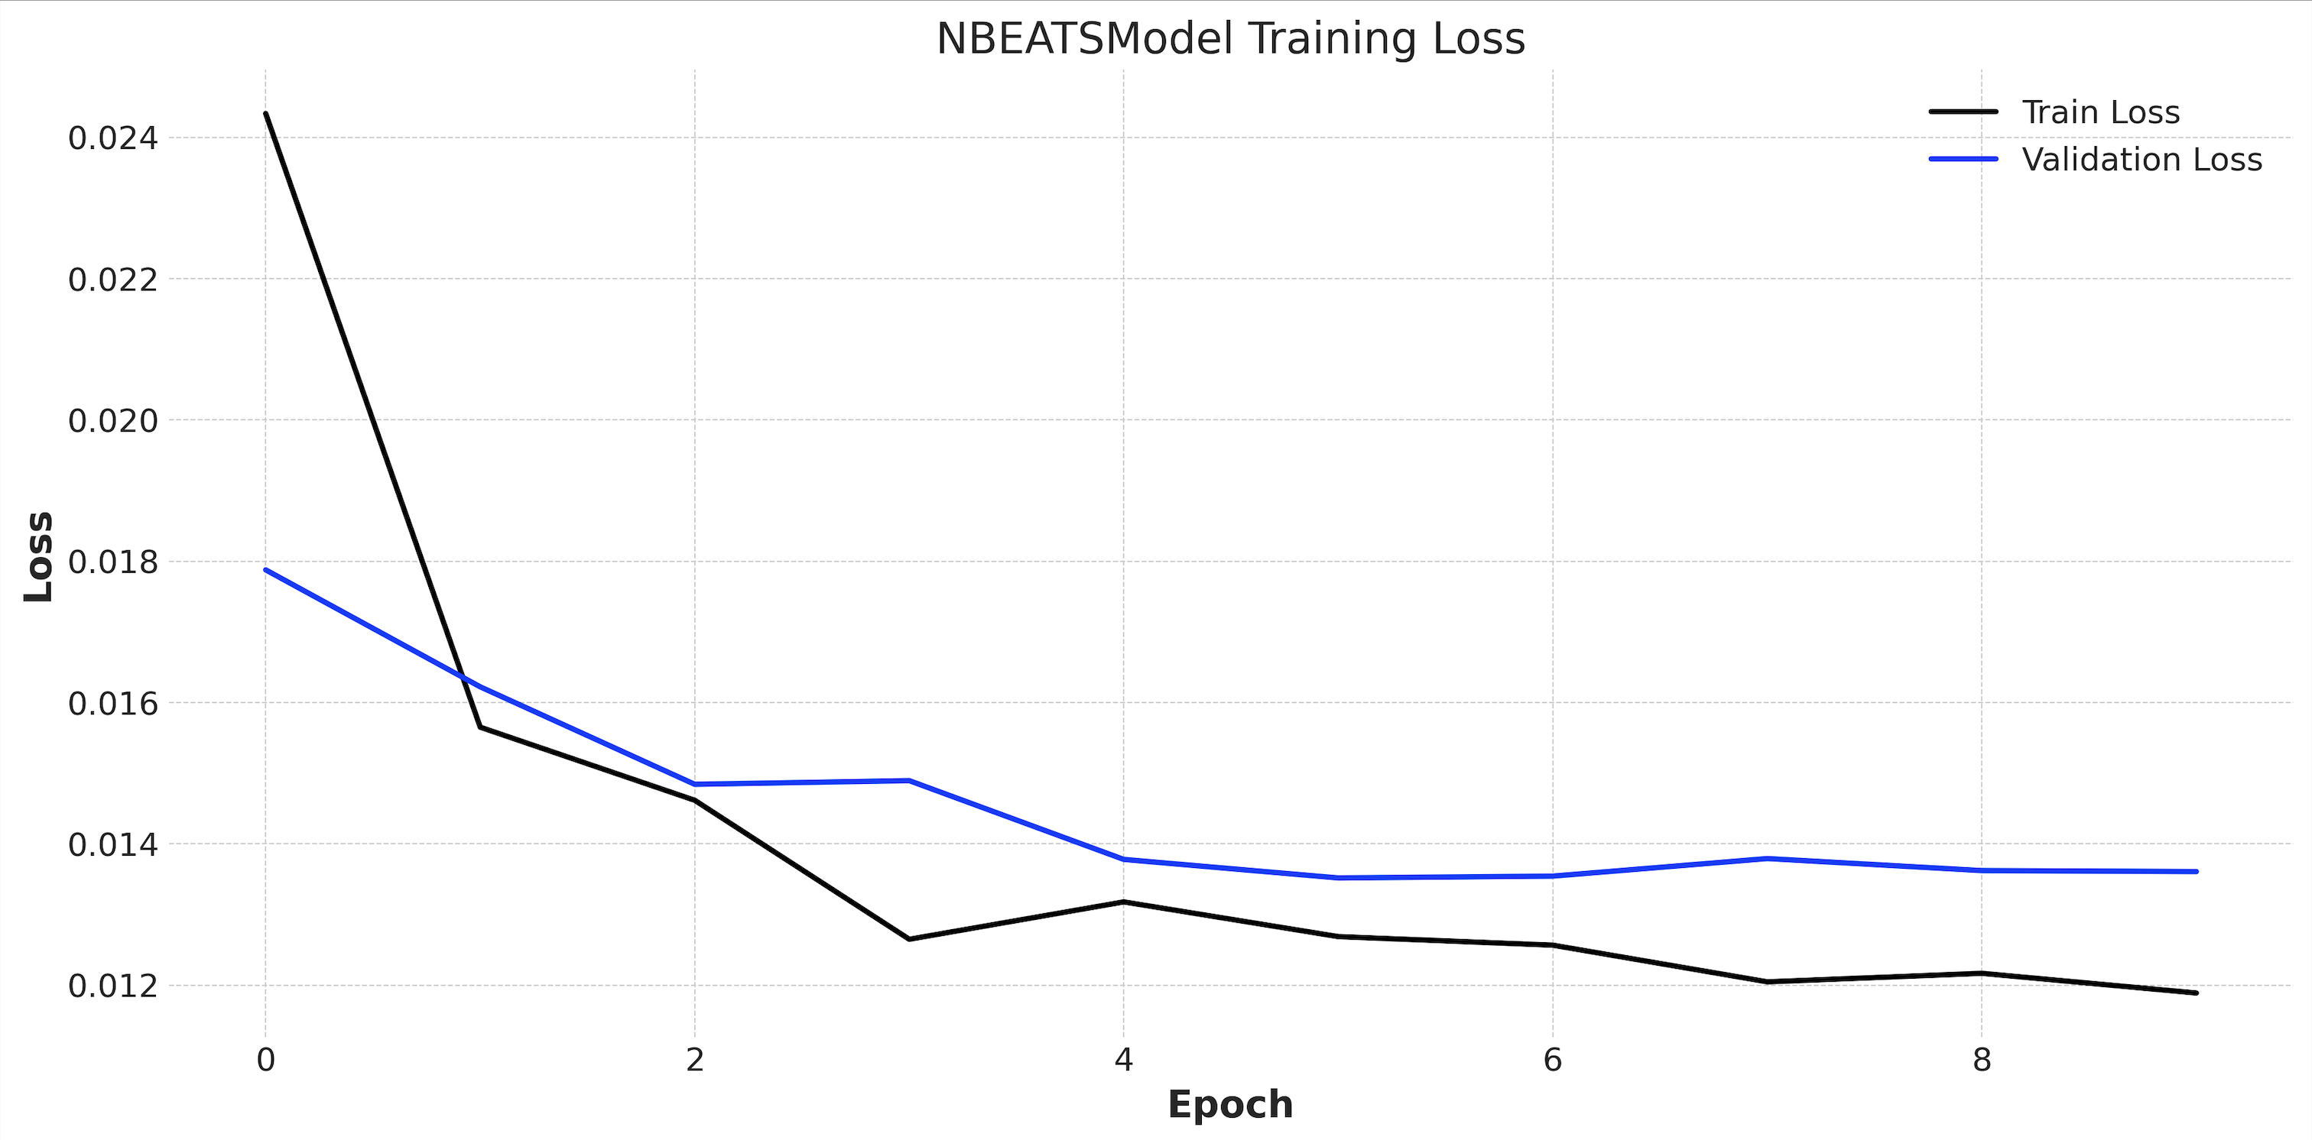
NBEATS Model Training Loss

Slide 18
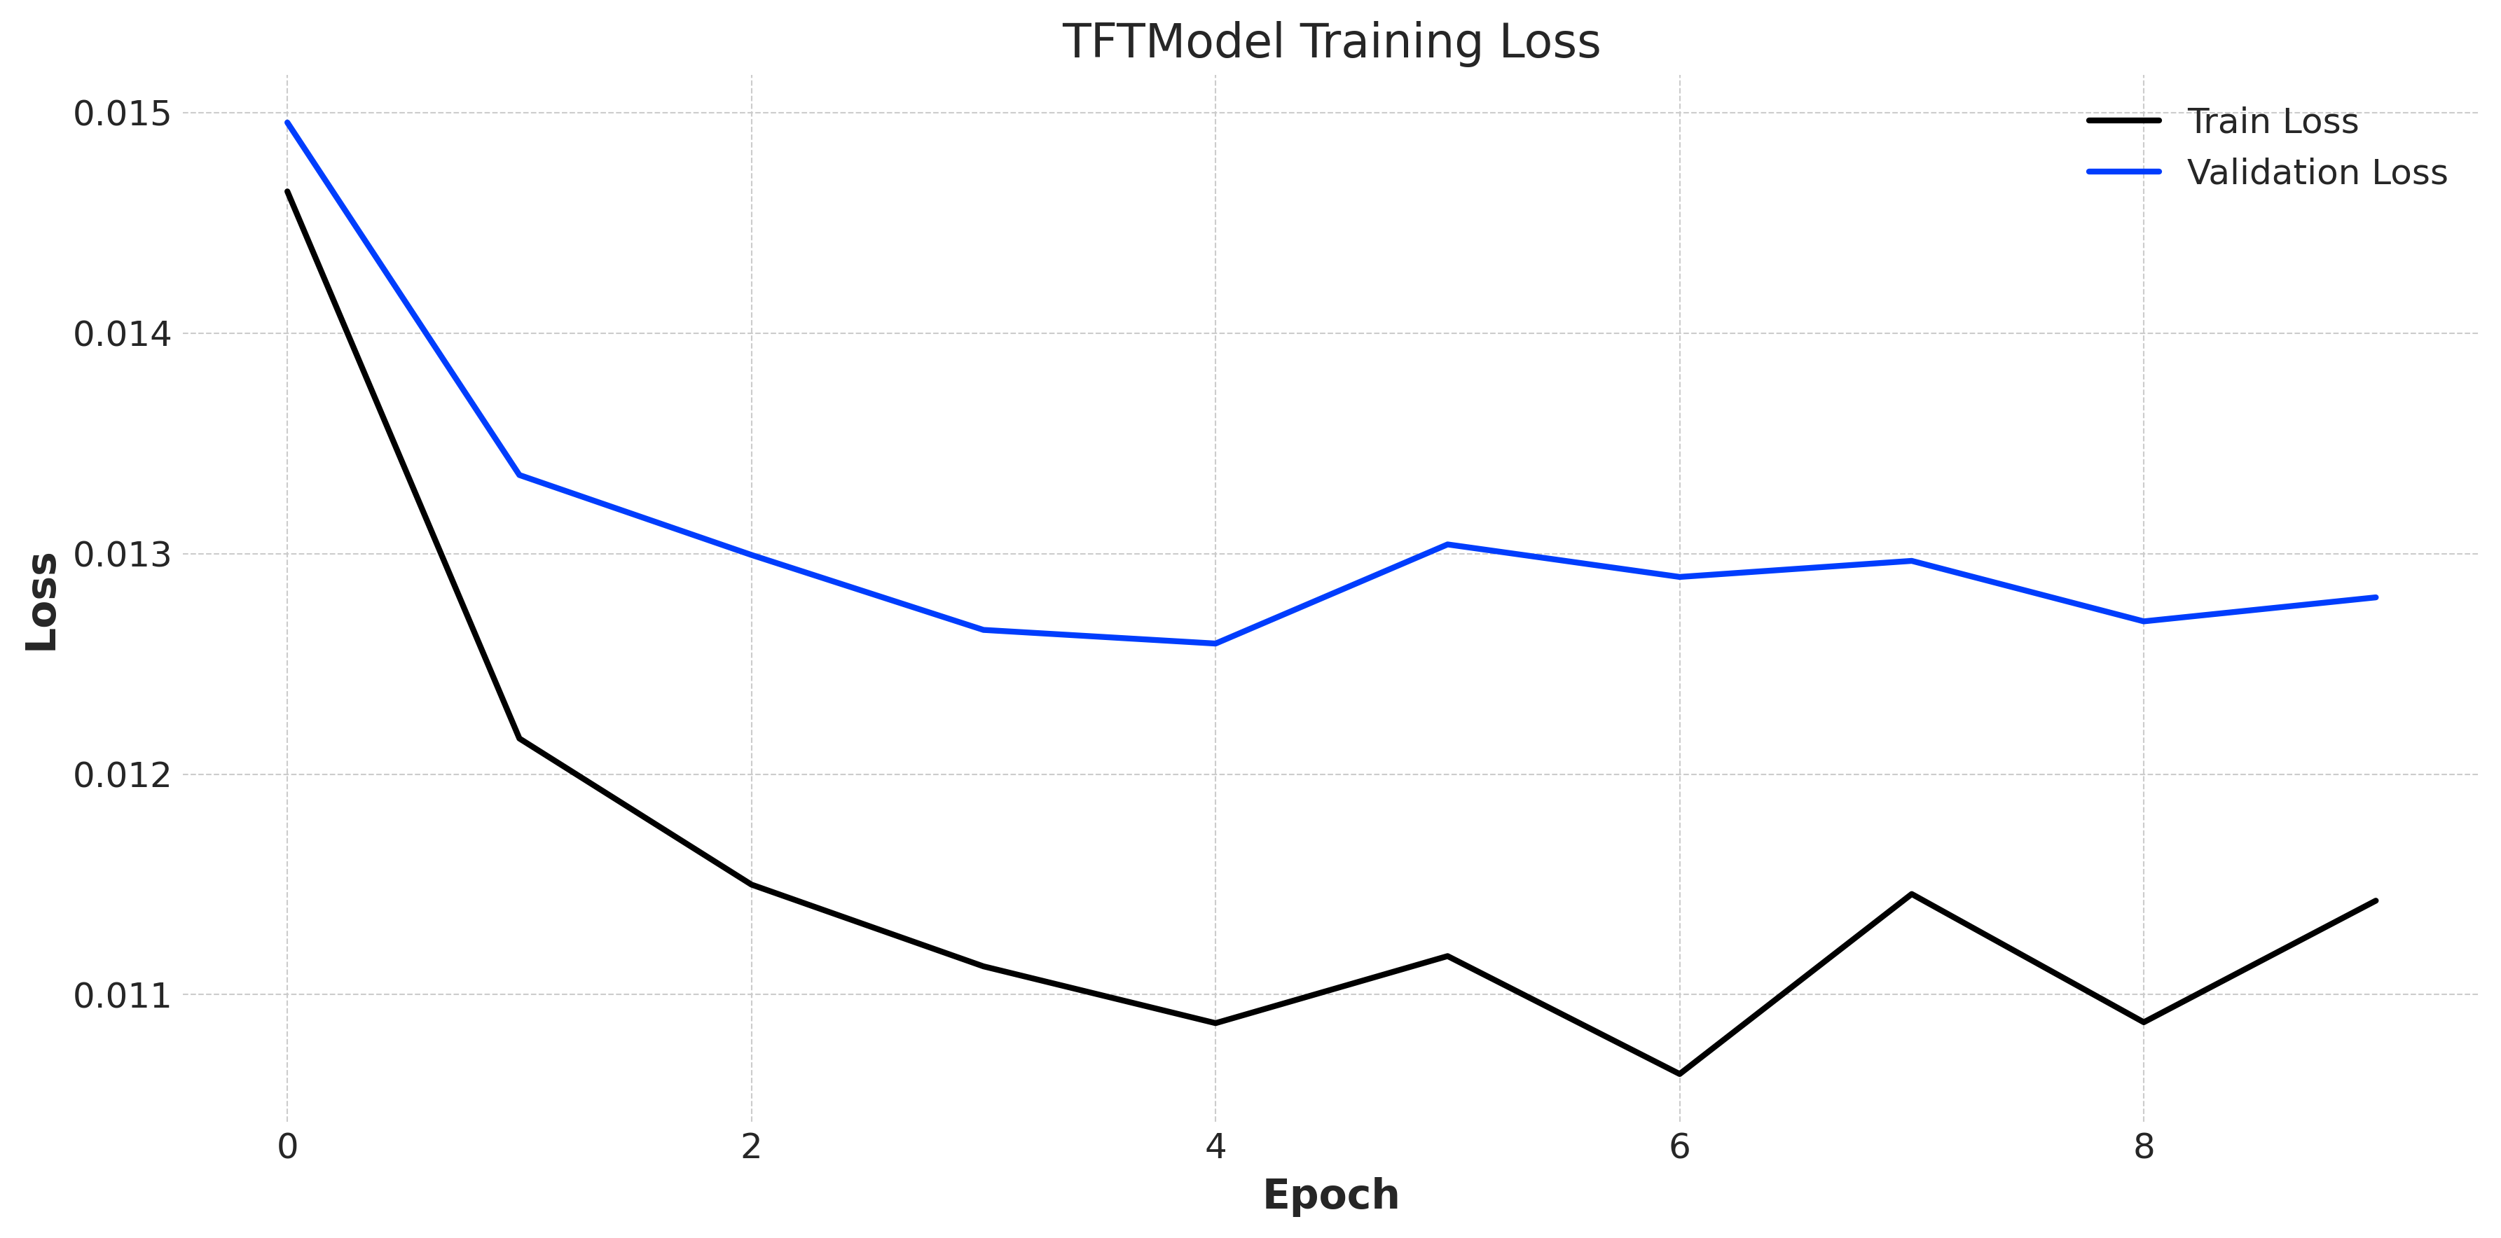
TFT Model Training Loss

Slide 19
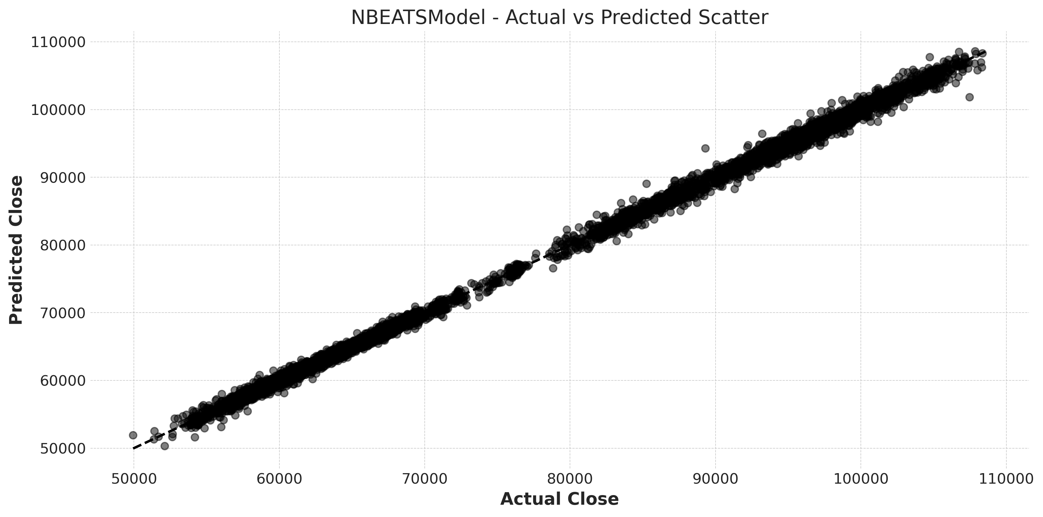
NBEATS – Scatter Plot

Slide 20
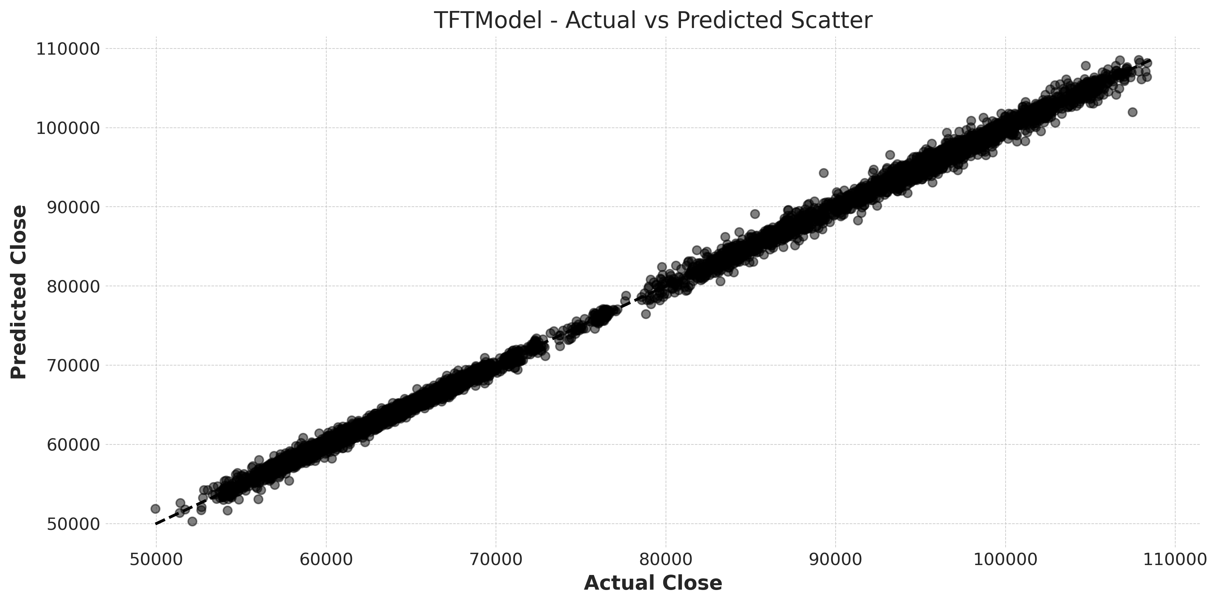
TFT – Scatter Plot

Slide 21
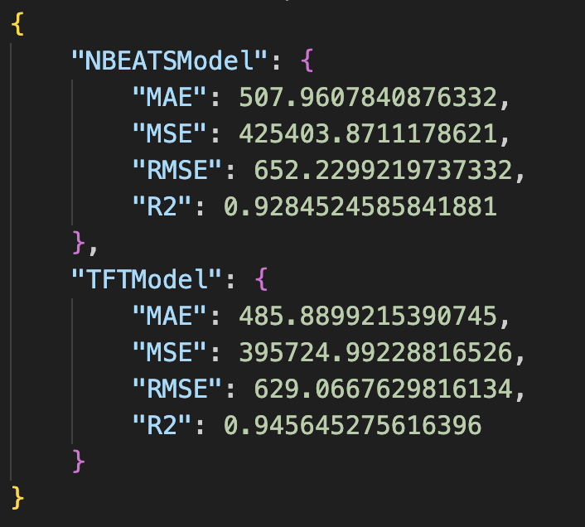
Results

Slide 22
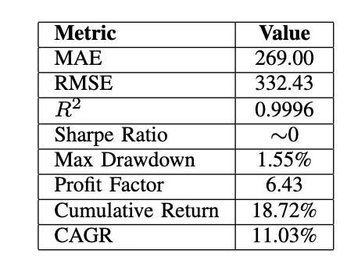
Backtesting Results
The analysis demonstrates both statistical and financial significance of the proposed forecasting ensemble. The model achieved high precision with an RMSE of 332.43, MAE of 269.00, and an R² of 0.9996. From a trading standpoint, it delivered an 18.72% total return, 11.03% CAGR, a 6.43 profit factor, and a low 1.55% maximum drawdown. Despite a near-zero Sharpe ratio—due to low volatility—the strategy remains effective for directional trades in quiet market conditions.

Slide 23






Explainability Module
MS Azure
Natural Language Response
Cosine
Similarity
Vector DB
GPT 4
Sentiments and OHLCV
Chunks
Embedding

Slide 24
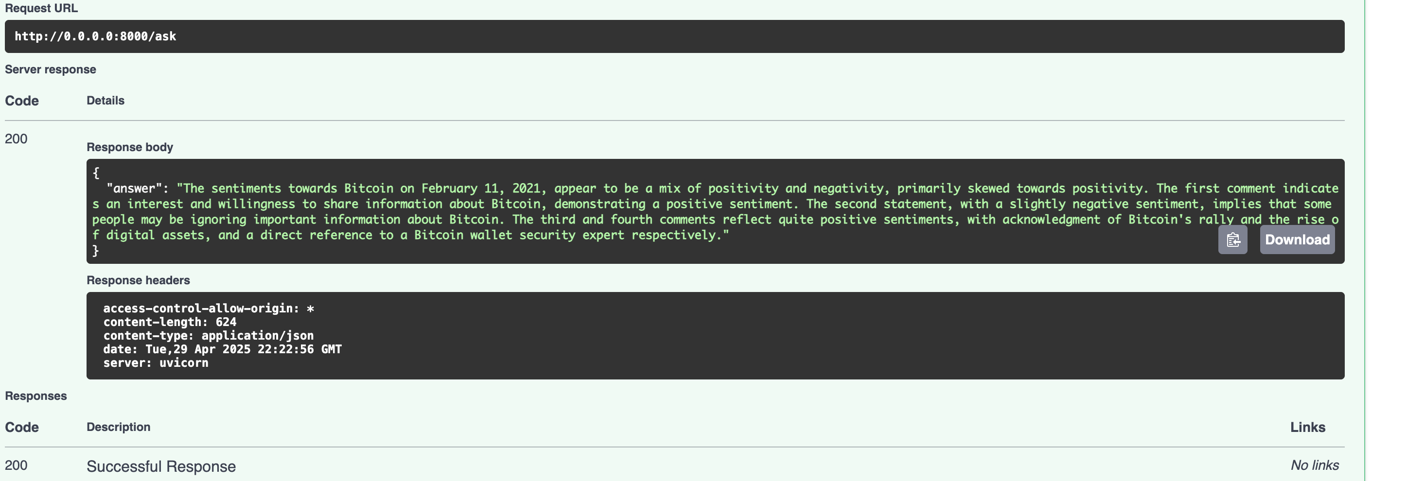
Explainability Module

Slide 25

Thank you!

